Slide 1
Predicting Obesity
© Templateswise.com
Machine Learning Project by Dustin White

Slide 2
What problem am I going to solve?
To accurately predict whether individuals are obese based on a range of categorical variables using Classification Models.
Obesity is a significant public health concern linked to numerous diseases such as diabetes. Early detection can help to prevent these diseases and improve public health.
By identifying patterns and relationships within this data, ML models can predict obesity in individuals.

Slide 3
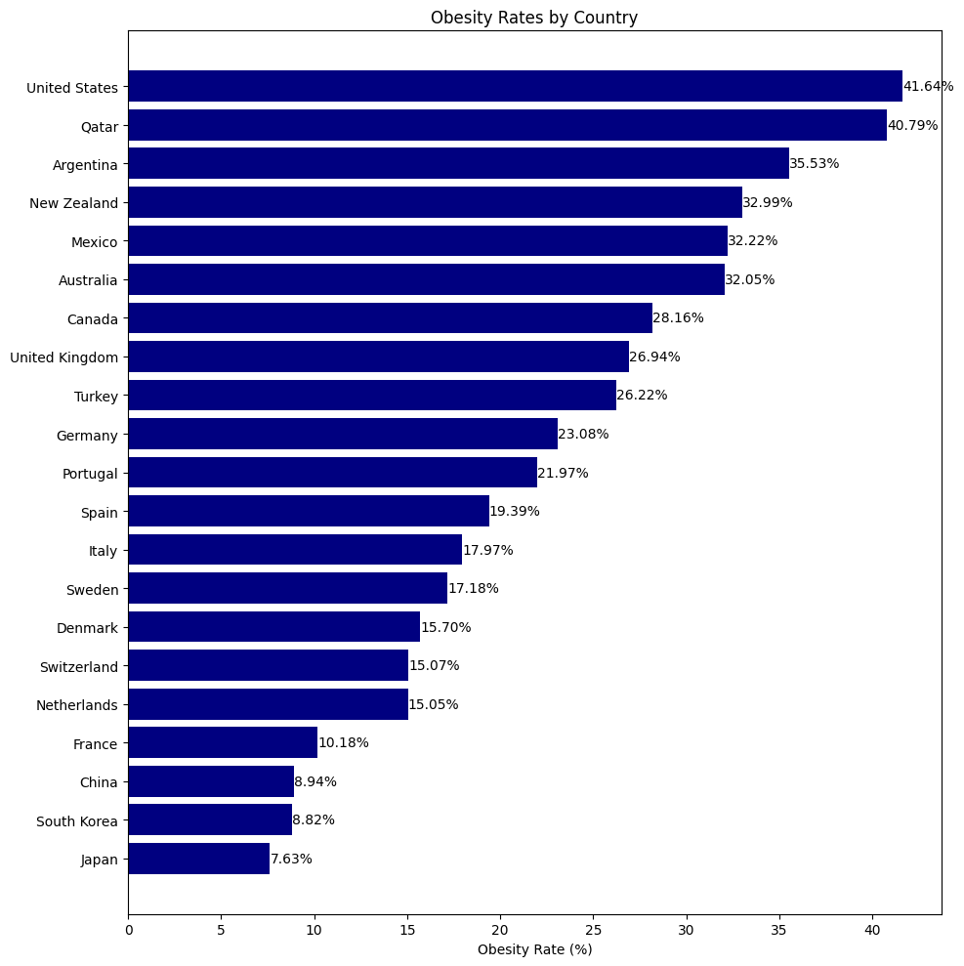

Slide 4
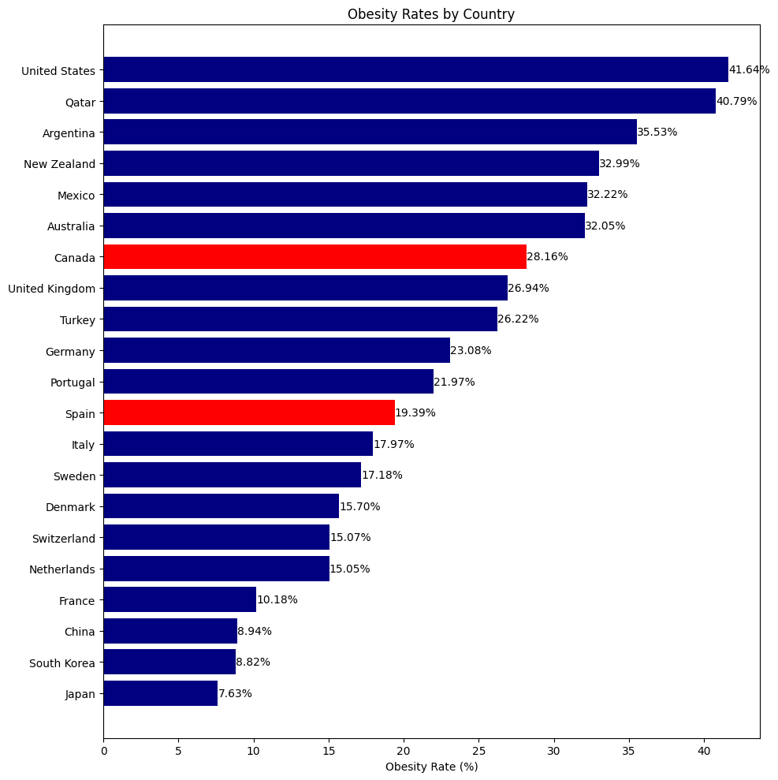

Slide 5
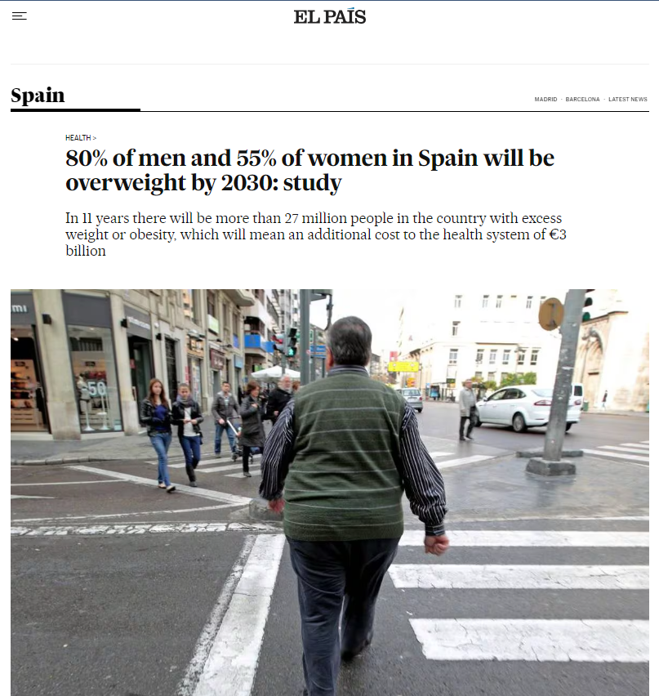

Slide 6


Categorical Variables
Province
Sex
Marital status
Age
Working (past 12 months)
Education level
Perceived life stress
Smoker
Drinker (past 12 months)
Physical activity
Has a regular healthcare provider
Immigrant
Cultural or racial background
Food security
Personal income

Slide 7
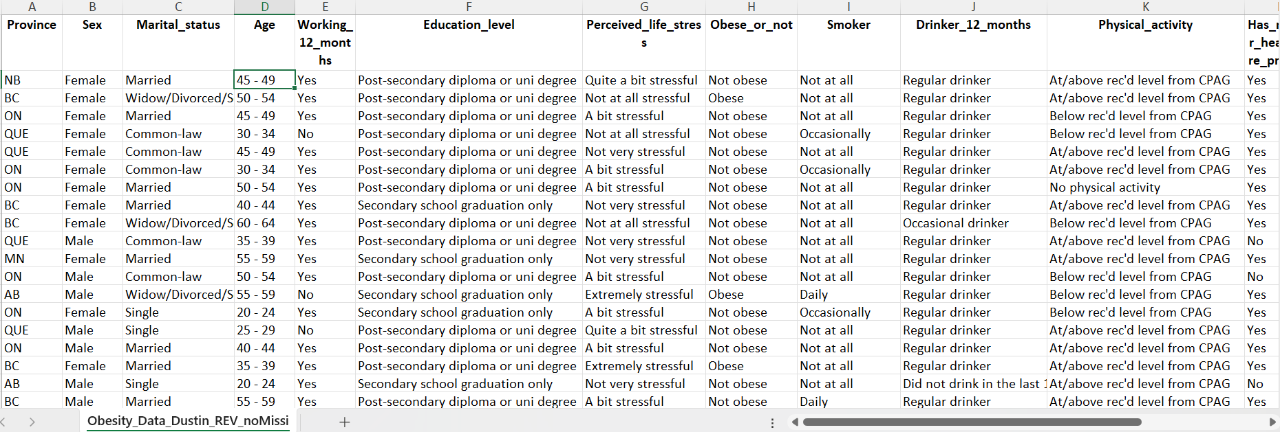

Slide 8
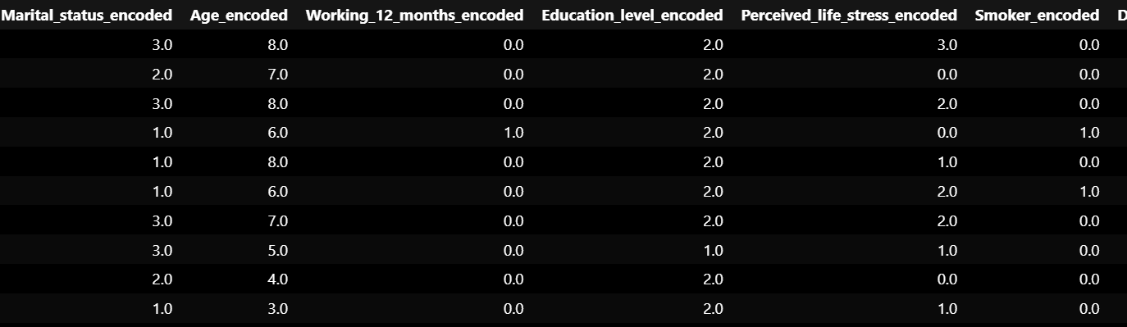

Slide 9
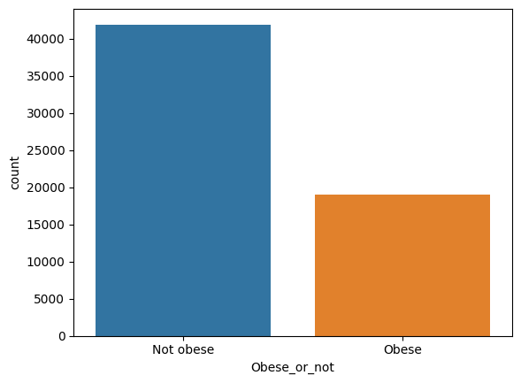
dataset
Categorical variables with records of (60920, 16)
Unbalanced:
Not obese: 41906
Obesese: 19014

Slide 10
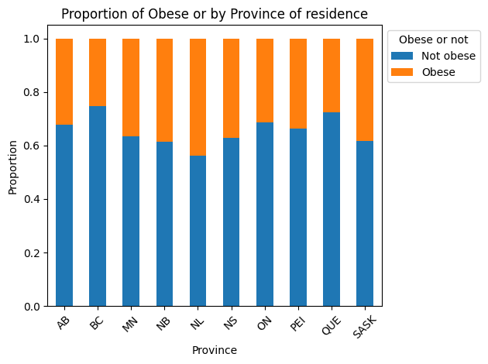

Slide 11
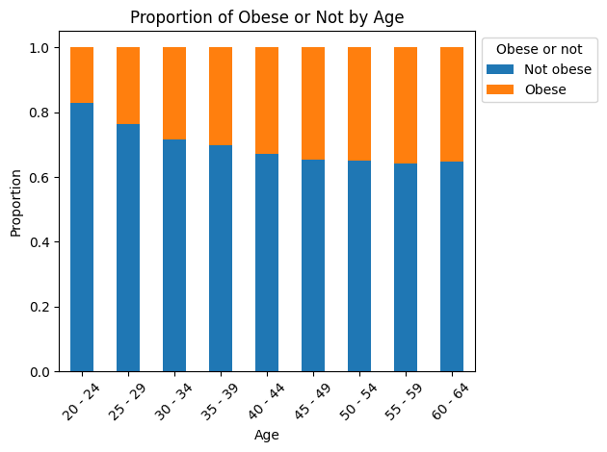

Slide 12
Machine Learning Models Used
Logistic Regression
Decision Trees
Random Forest
XGBoost
SVM

Slide 13
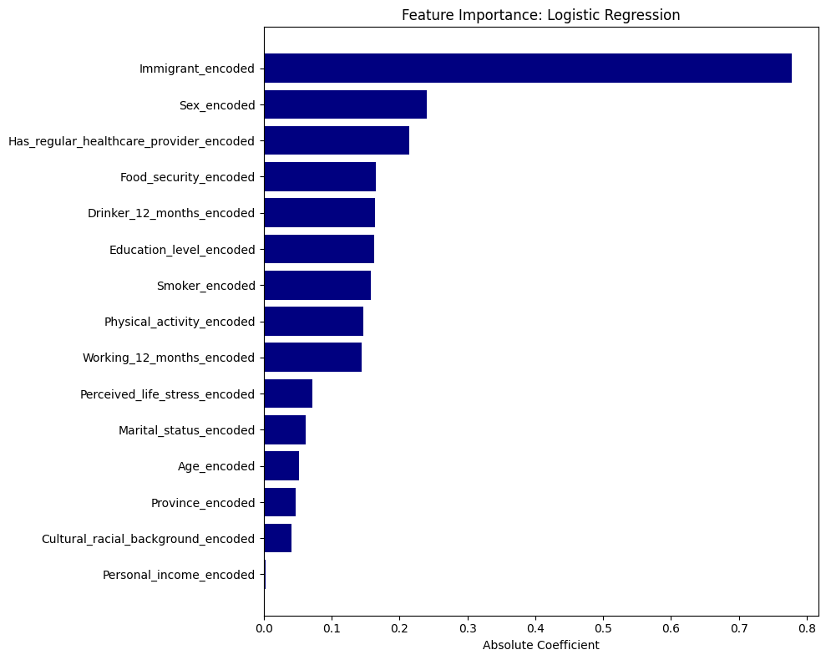

Slide 14
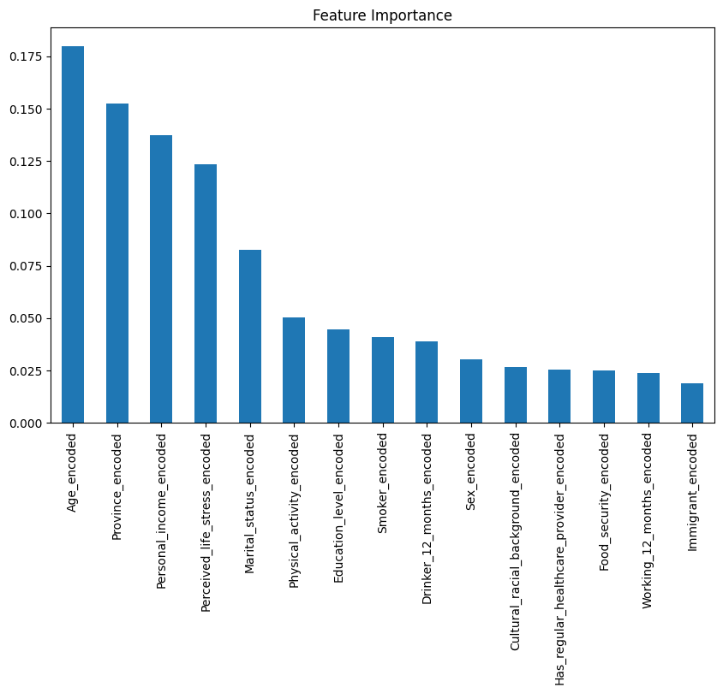
Feature Importance: random forest

Slide 15
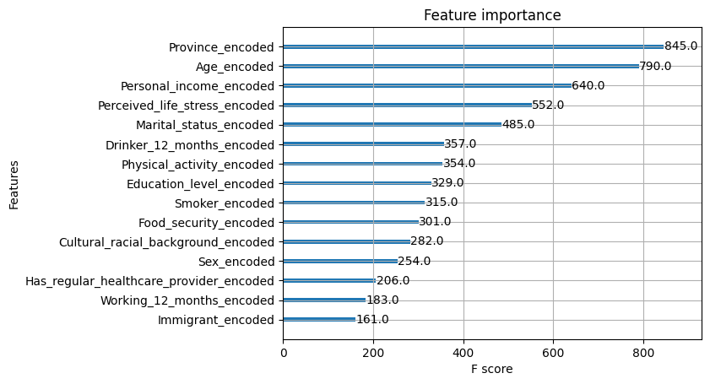
Feature importance: xgboost

Slide 16
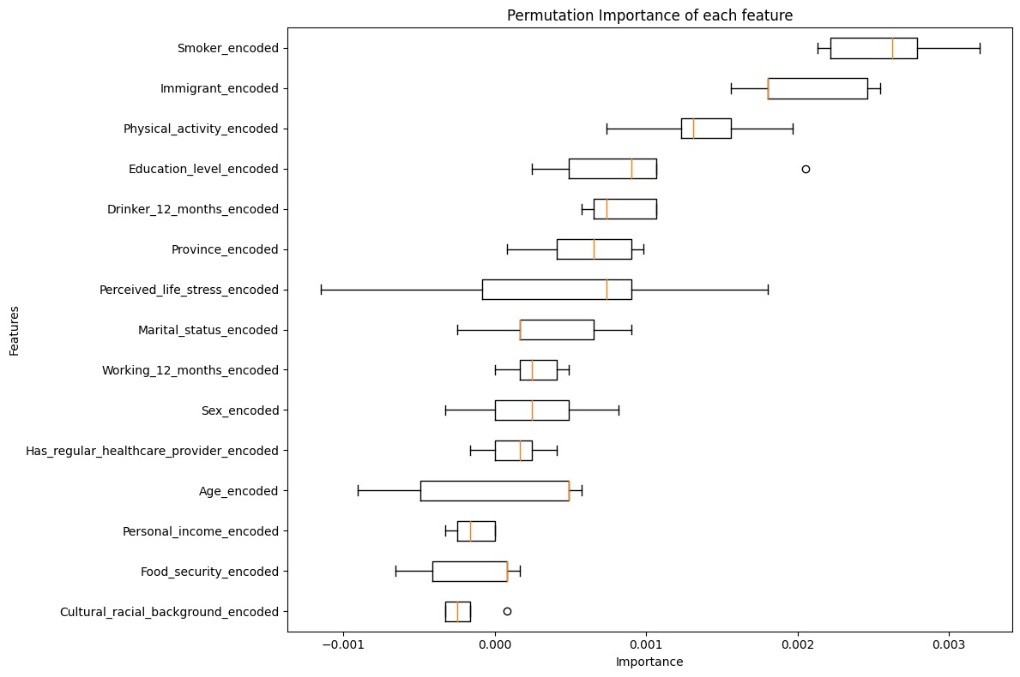

Slide 17
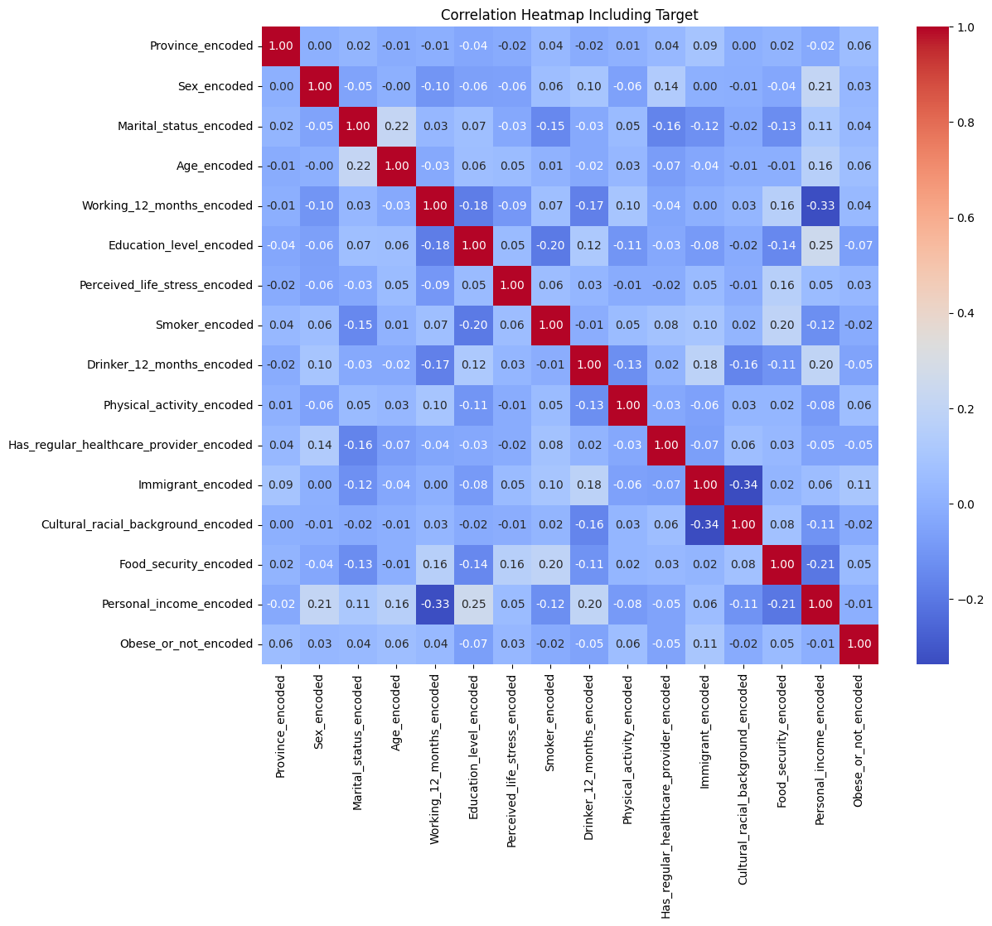

Slide 18
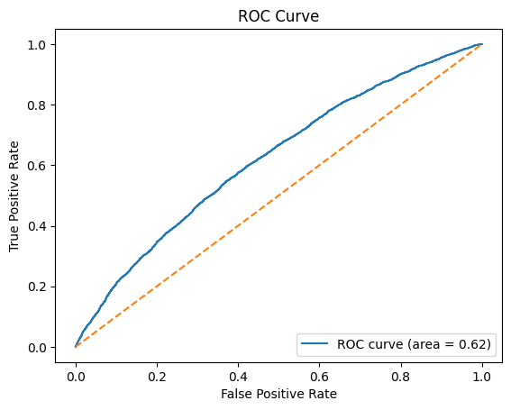
Logistic regression: 1st attempt default
Accuracy: 58%
F1 score: 8%

Slide 19
Logistic regression: final attempt ‘weighted’
Accuracy: 61%
F1 score: 45%

Slide 20
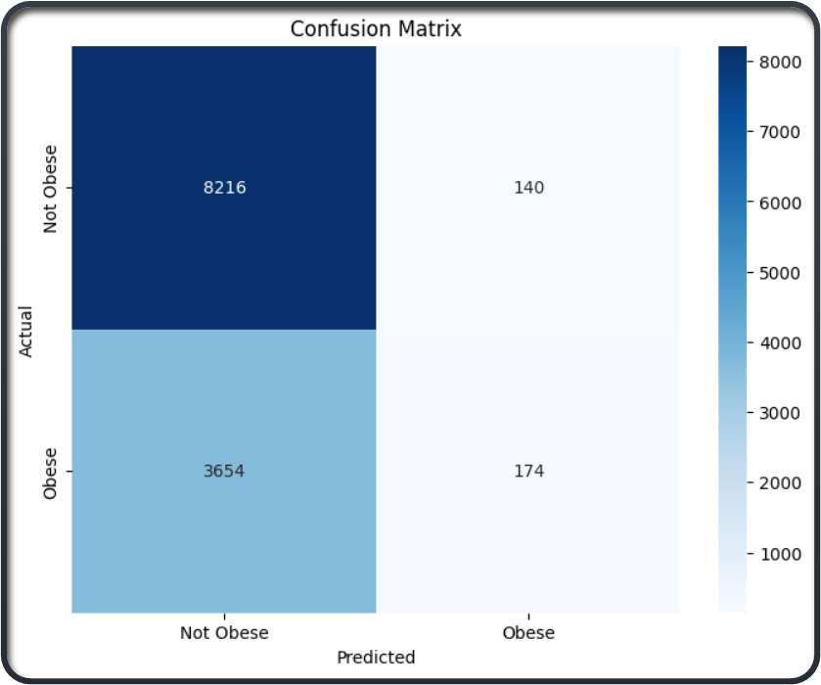
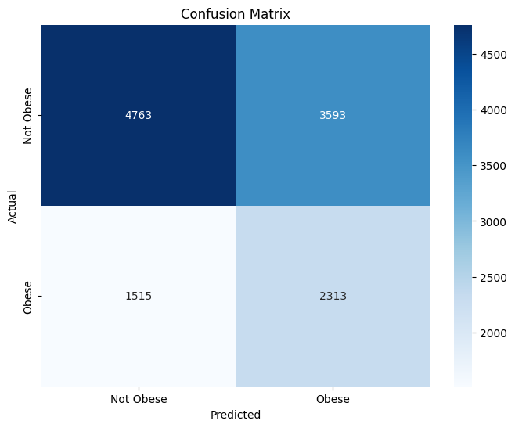
Logisitc Regression: first attempt vs balanced

Slide 21
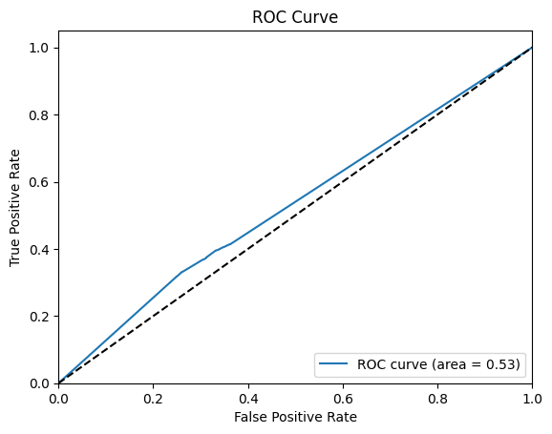
Decision trees model: 1st attempt
Accuracy: 58%
F1 score: 36%

Slide 22
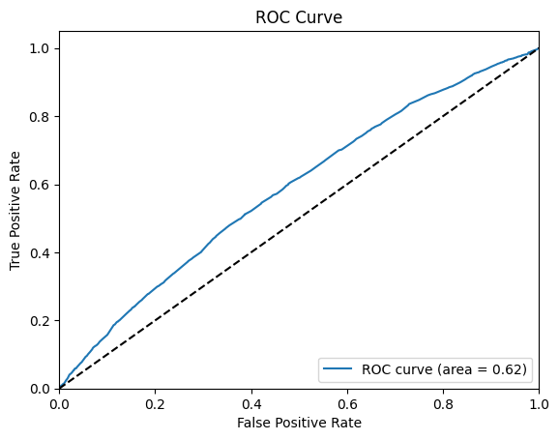
Decision trees model: parameter grid
Accuracy: 68%
F1 score: 19%

Slide 23
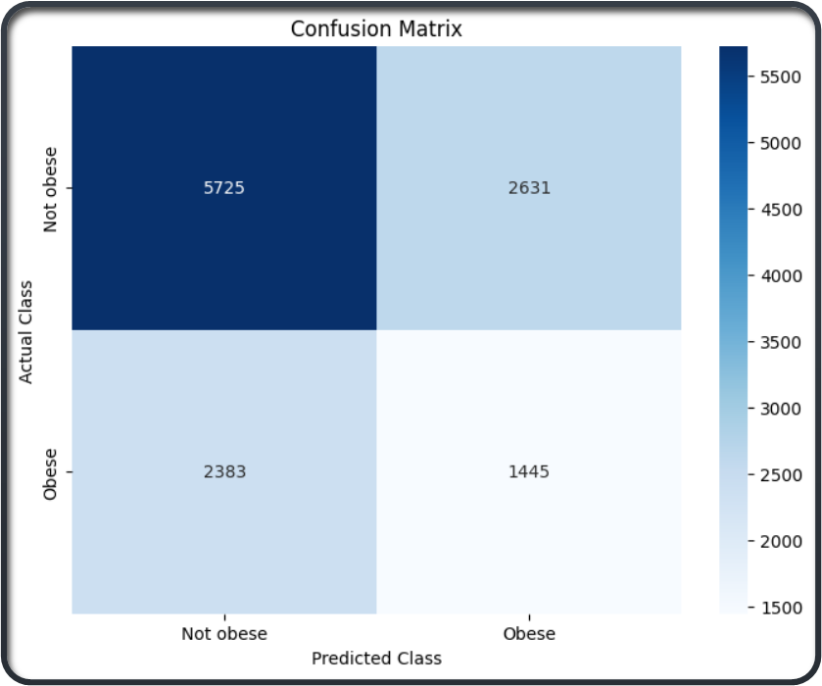
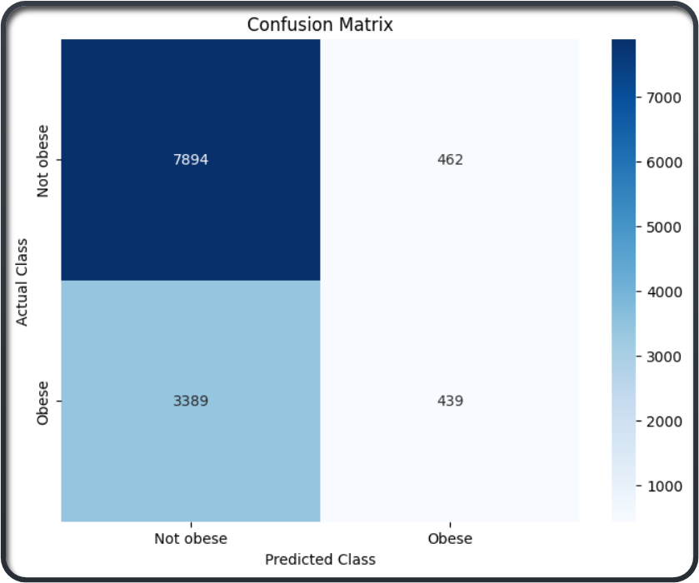
Decision trees 1st attempt vs parameter grid

Slide 24
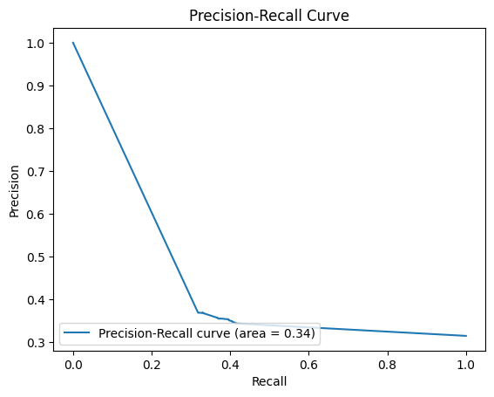
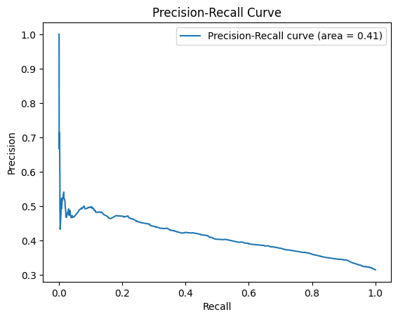
Decision Tree 1st Attempt vs Parameter Grid

Slide 25
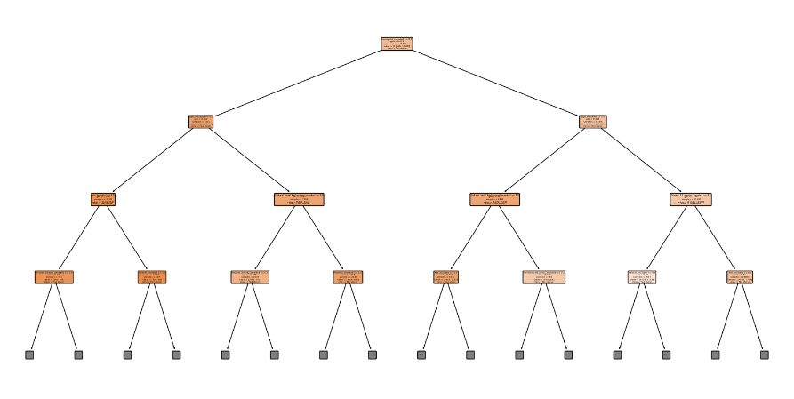
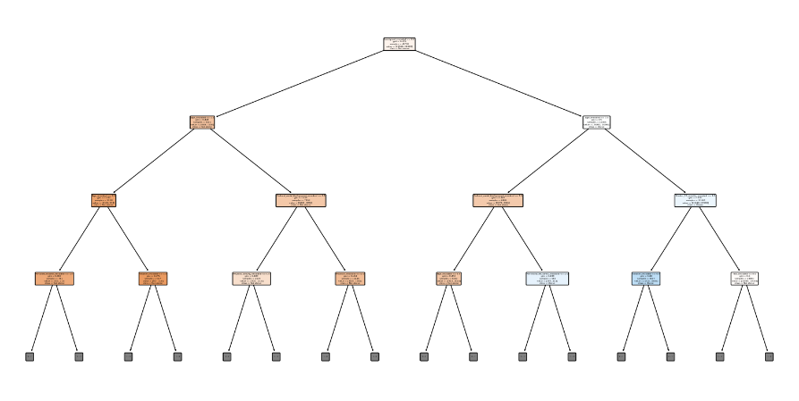

Slide 26
Decision trees: recursive elimination
All metrics got worse
Accuracy and F1 decreased along with the ROC-AUC score.

Slide 27
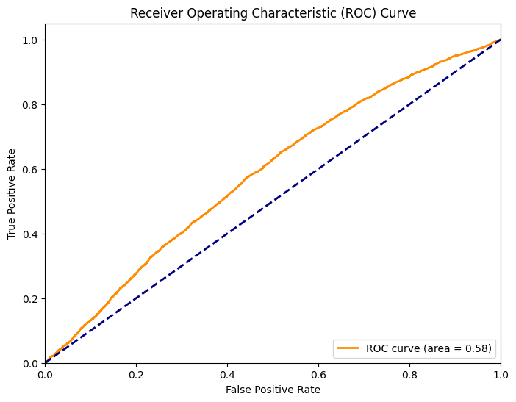
Random forest model: 1st attempt
Accuracy: 64%
F1 score: 29%

Slide 28
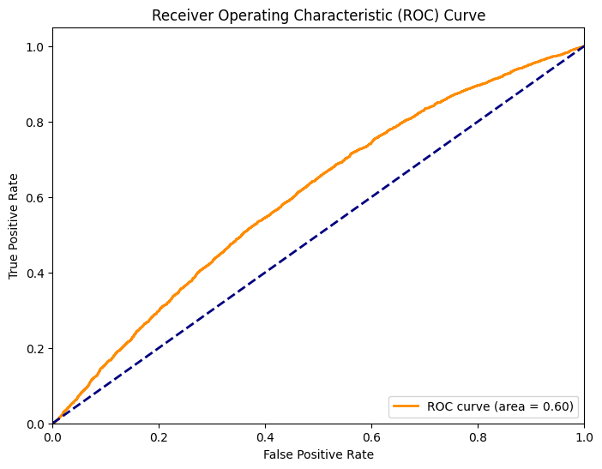
Random forest model: SMOTE TO BALANCE CLASSES
Accuracy: 63%
F1 score (weighted average): 62%

Slide 29
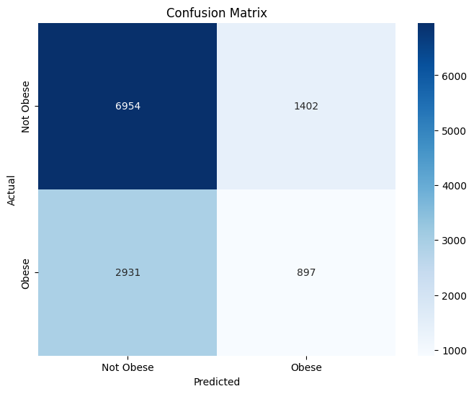
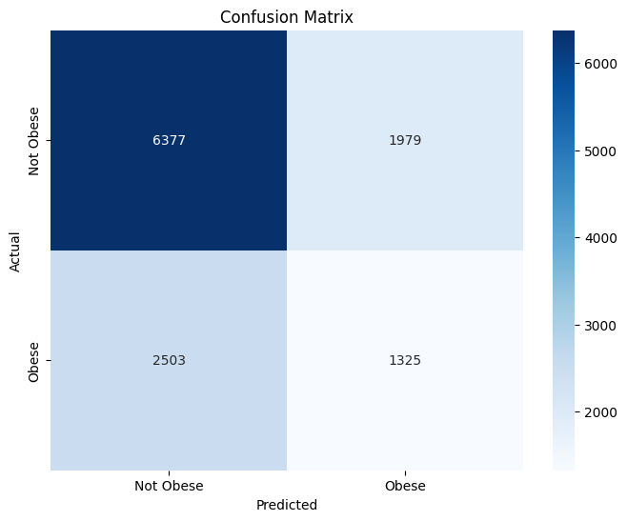
Random forest: 1st attempt compared to smote

Slide 30
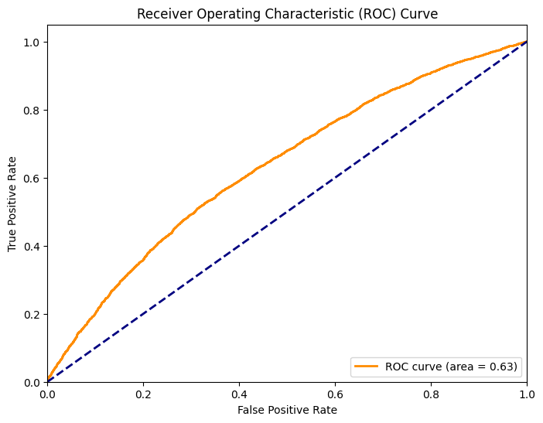
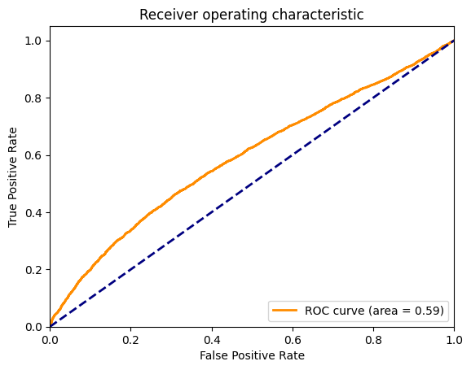
XGBOOST: 1st attempt vs hyperparameter tuning

Slide 31
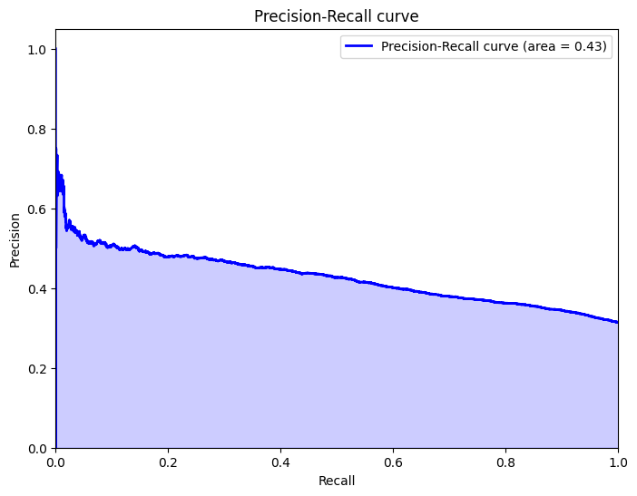
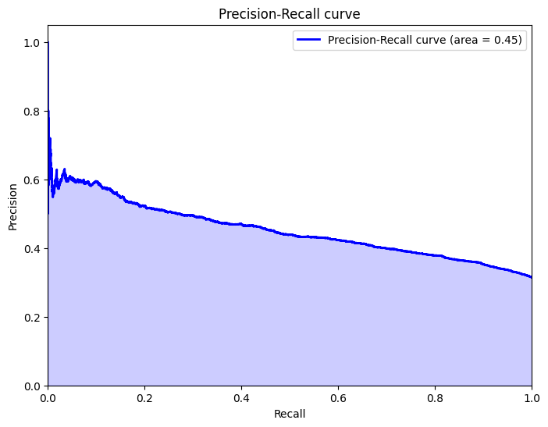
XGBOOST: 1st attempt vs hyperparameter tuning

Slide 32
XGBOOST: 1st attempt vs hyperparameter tuning
Metrics got only slightly better
Accuracy: 60%
F1: 62%
Accuracy: 65%
F1: 62%

Slide 33
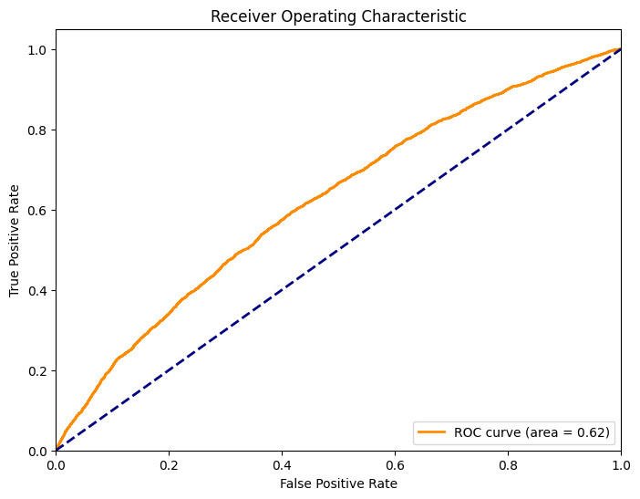
SVM: linear model vs RBF Kernel with RandomizedSearchCV
Accuracy: 68%
Accuracy: 69%

Slide 34
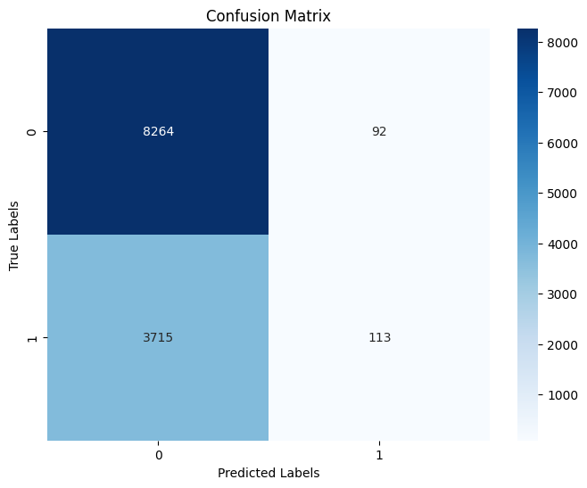
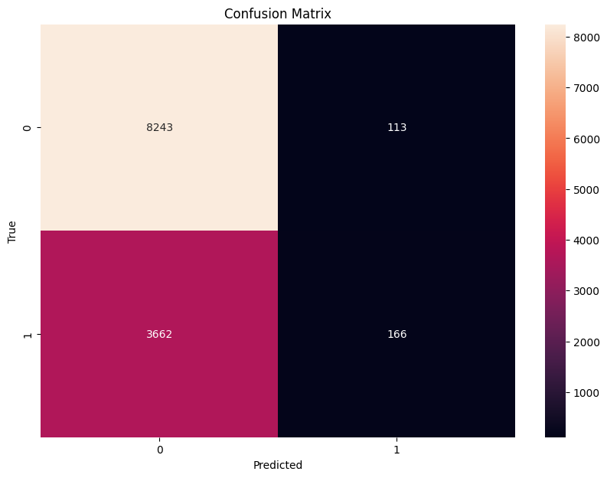
SVM: linear model vs RBF Kernel with Randomized Search CV

Slide 35
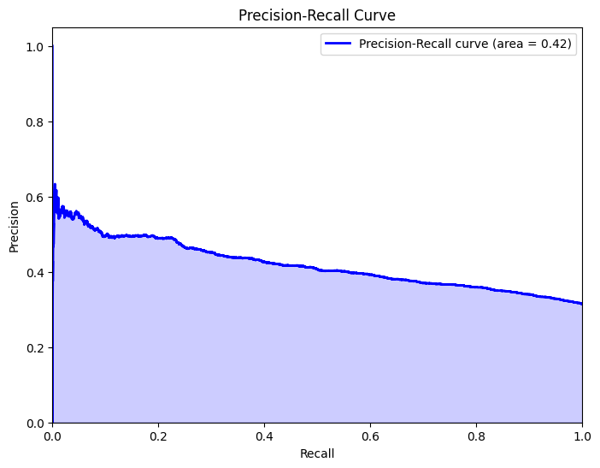
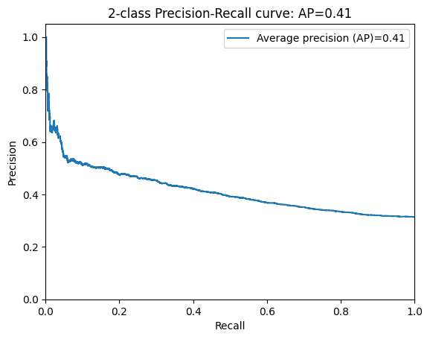
SVM: linear model vs RBF Kernel with RandomizedSearchCV

Slide 36
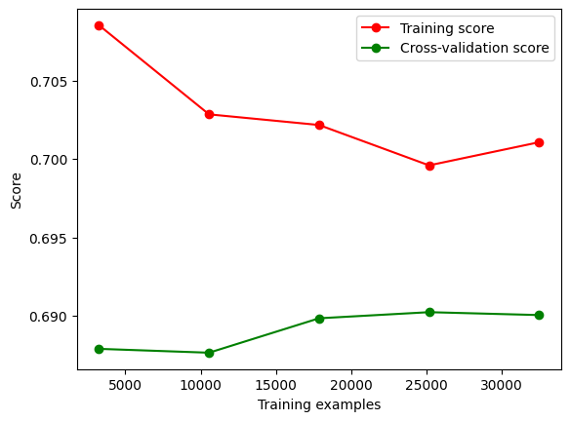

Slide 37
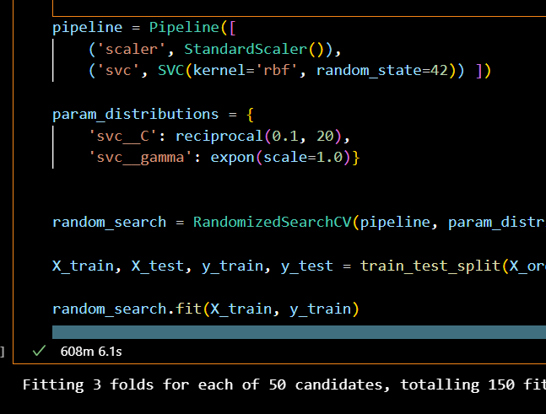
Took awhile…

Slide 38
Which model worked best in the end?
Best Accuracy: SVM: RBF Kernel with RandomizedSearchCV
Best F1 score: XGBOOST with Hyperparemeter tuning
Best ROC-AUC: XGBoost 1st attempt
Best Precision-Recall: XGBoost 1st attempt

Slide 39
Recall is arguably the best metric in this case
Why?
Recall is the best because the cost of false positives is low.
If someone is overweight and is falsely classified as ‘obese’, the worst thing to happen is that their doctor would tell them to take their weight more seriously.
This differs from other health-related models where the the cost of a false positive could potentially lead to unnecessary, treatments like medication or surgery.

